Slide 1

Transformer
Sourish Dasgupta
Associate Professor, DAU, Gandhinagar
https://daiict.ac.in/faculty/sourish-dasgupta

Slide 2
Contextual Embedding

Slide 3
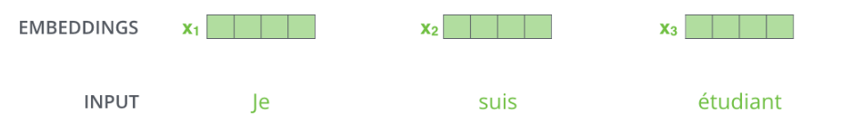
Static Embedding (e.g. Word2Vec embeddings)
x
x
John
Mary
loves
x
x
milk
Cat

Slide 4
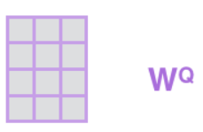
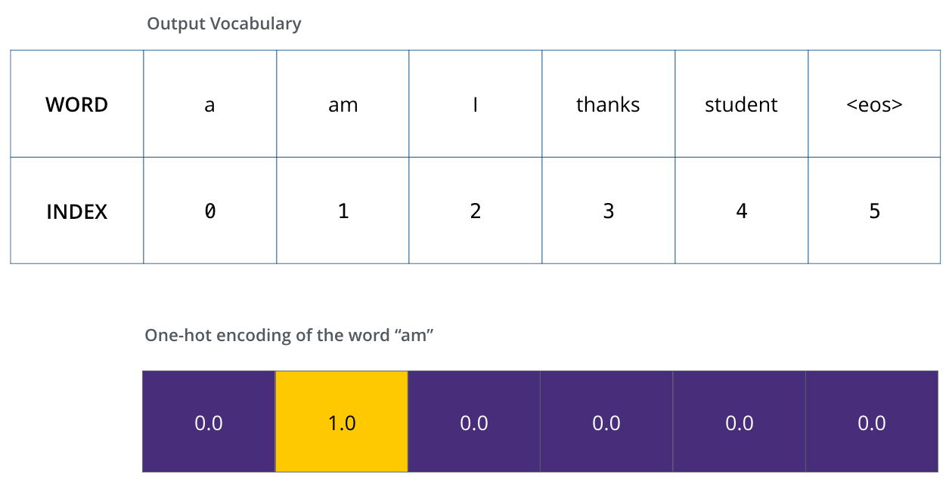
Where to get initial embedding (x)? → One-hot Vector/tf-idf/word2vec

Slide 5

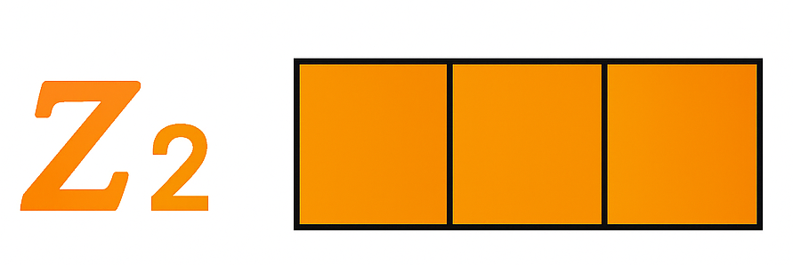
Contextual Embedding
loves
x
Influence
%
%
John
Mary
loves
%
%
milk
Cat

Slide 6
Contextual Embedding (n-gram-style)
%
%
John
loves
Mary
x
Unless bi-directional RNN-styled

Slide 7
Contextual Embedding (bi-directional skip-gram-style)
%
skips “loves”
%
John
loves
Mary

Slide 8
Self-Attention

Slide 9
What is self-attention?
(“skip”) Influence = self-attention
%
%
John
loves
Mary

Slide 10
Why “self”?
%
%
John
loves
Mary
x
x
Ann
admires
Mary

Slide 11
How to compute Attention (i.e. %)?

Slide 12
Computing self-attention (Attn.)
Attention stands for “what’s upcoming”
%
“what’s upcoming” implies strong “association”
“Association” implies “relatedness”
%
How to compute “relatedness”?
John
loves
Mary

Slide 13
Computing self-attention (Attn.)
%
%
John
loves
Mary
Similarity → Dot Product
Similarity(John, Mary)
x₁ . x₃ = x₁ ^{T} x₃

Slide 14

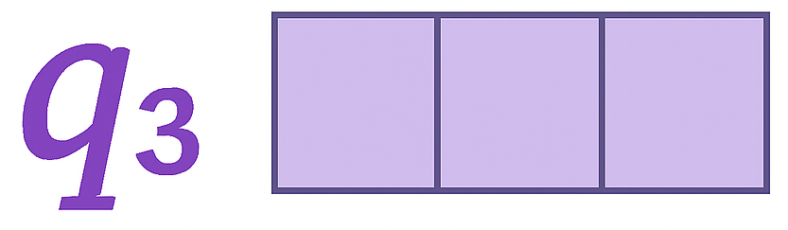
Initial embedding is not contextual (and reliable)
can be far in the HD vector space
John
makes follow-up learning difficult
Mary
John_{q}
Mary_{q} → Query (Target)
Similarity → Dot Product
q₁ . q₃ = q₁ ^{T} q₃

Slide 15
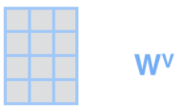

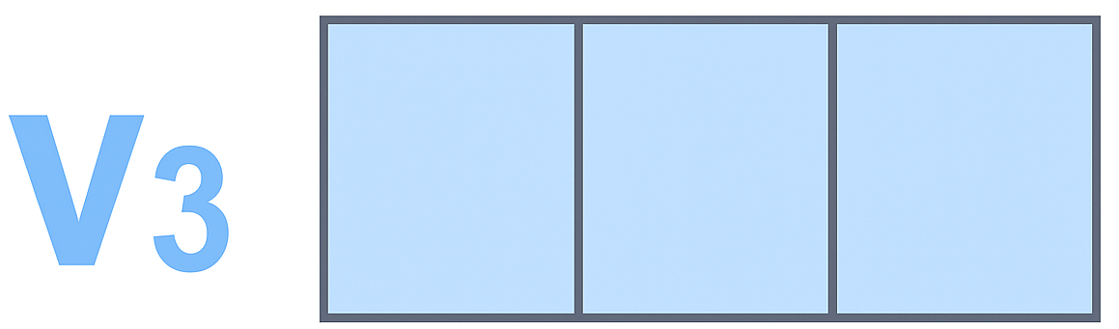
Query (q) embedding is the receiver (not donor) – need a donor (Value (v)) avatar
Similarity → Dot Product
v₁ . q₃ = v₁ ^{T} q₃
John
Mary
John_{q}
Mary_{q} → Query (Target)
%
John_{v}
Mary_{v}

Slide 16
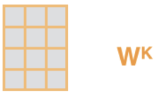

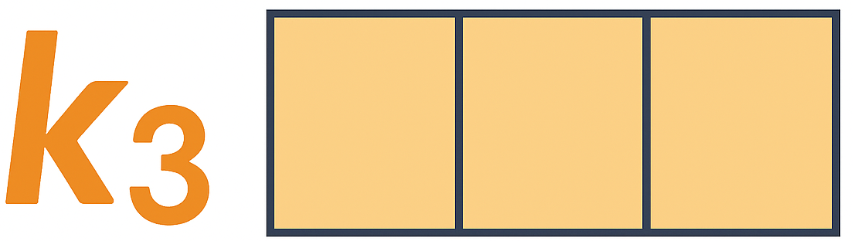
Need relatedness (not similarity) → Donor (Value) may not have to be close
Similarity → Dot Product with Key (access to Value)
k₁ . q₃ = k₁ ^{T} q₃
John
Mary
John_{q}
Mary_{q} → Query (Target)
%
John_{v}
Mary_{v}
John_{k}
Mary_{k}

Slide 17
How to get % from Dot Product?
% = Softmax(k₁ . q₃ )
John
Mary
John_{q}
Mary_{q} → Query (Target)
%
John_{v}
Mary_{v}
John_{k}
Mary_{k}

Slide 18
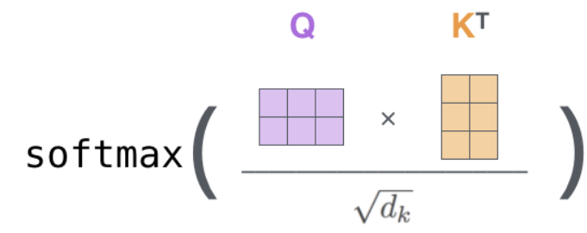
What if the Dot Product explodes? → Higher influence can get exaggerated
% =
John
Mary
John_{q}
Mary_{q} → Query (Target)
%
John_{v}
Mary_{v}
John_{k}
Mary_{k}

Slide 19
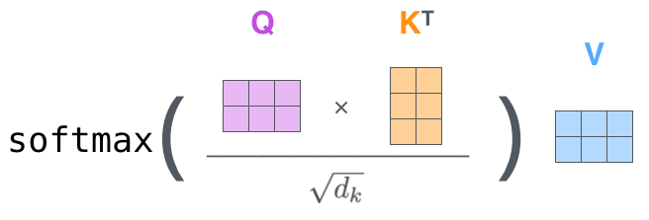
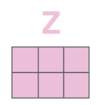
Getting back to the Donor (Value)
=
John
Mary
John_{q}
Mary_{q} → Query (Target)
%
%
John_{v}
Mary_{v}
John_{k}
Mary_{k}

Slide 20
The Transformer Architecture

Slide 21
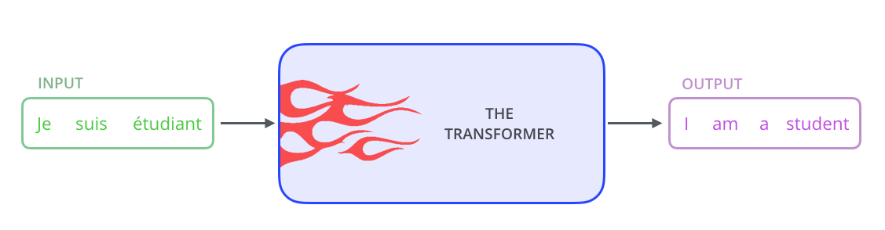
Transformer Architecture (Task: Machine Translation)

Slide 22
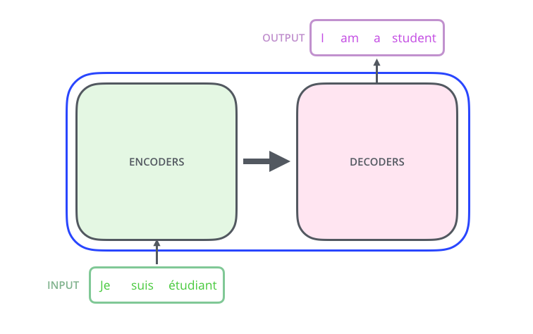
Transformer Architecture: Encoder-Decoder Model

Slide 23
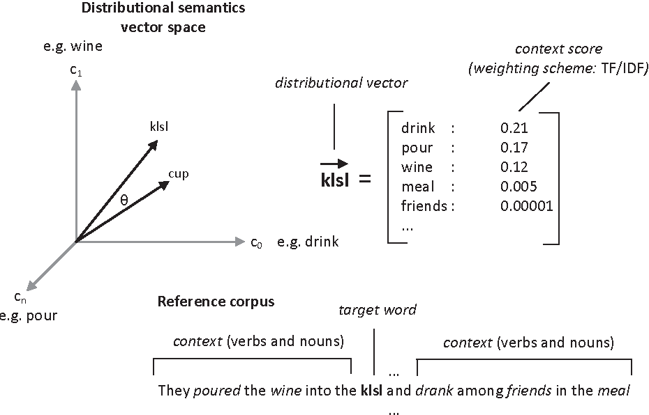
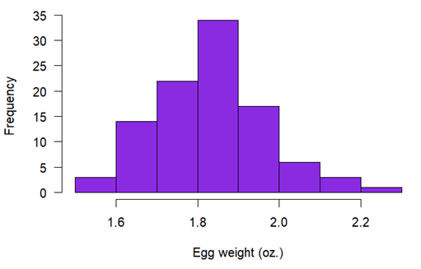
DECODER TASK: Next token prediction
-ness
p(x_{t=5} = drink | START→pour → wine → klsl )
??
-ness
-ness
??
-ness
Arg max: x*_{t}
Notes:
Capybara vs nutria

Slide 24
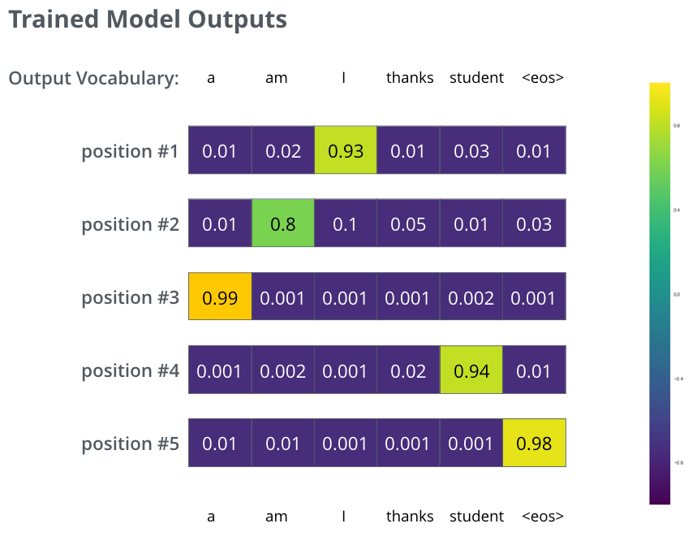
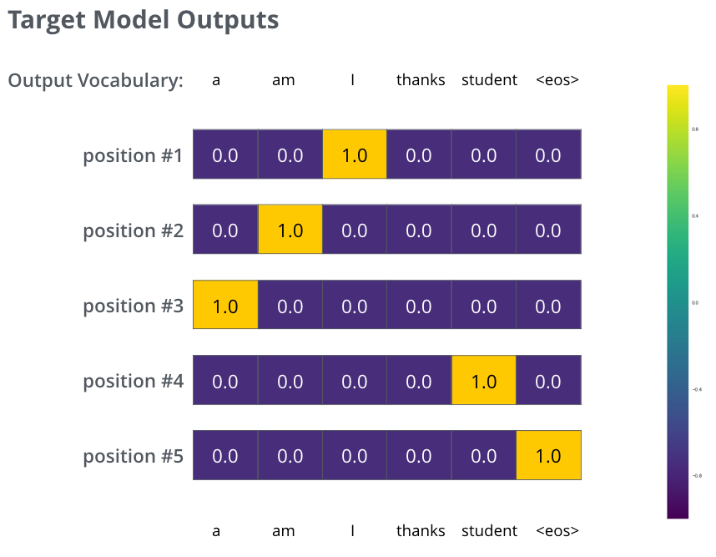
Training the Transformer (DECODER TASK: Next token prediction)
p(x_{t=5} = w₆-ness | w₃→w₂ → w₁ → w₅ )
= 1 (ideally)

Slide 25
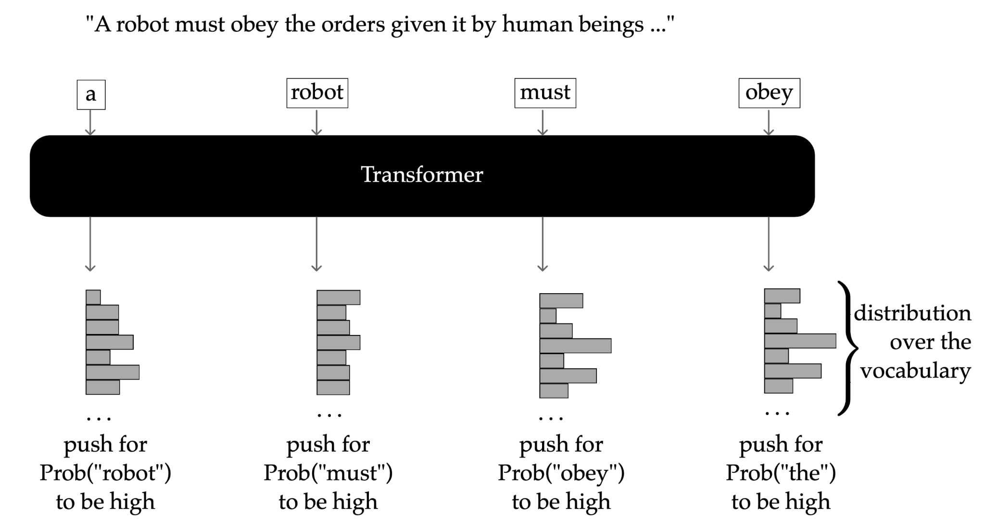
Decoder → Causal (Auto-regressive) Language Model (CLM)

Slide 26
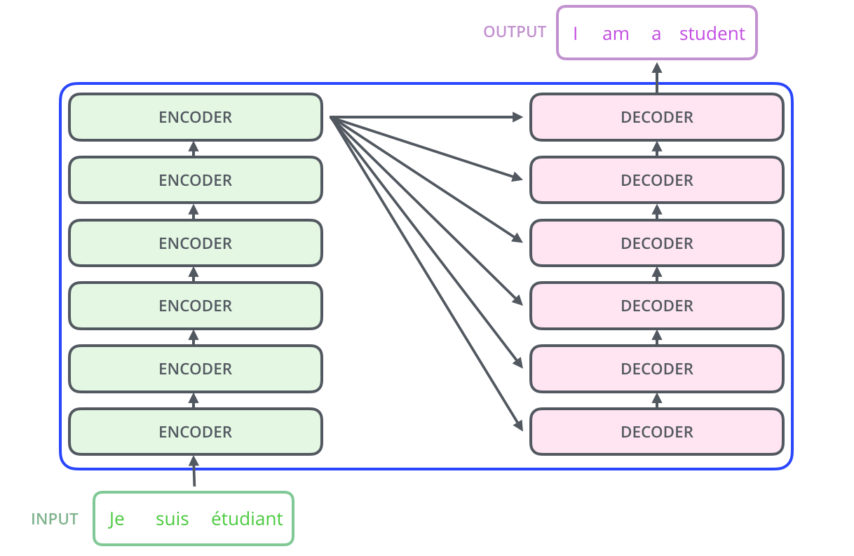
Transformer Architecture: Multi-layer Encoder-Decoder Model

Slide 27
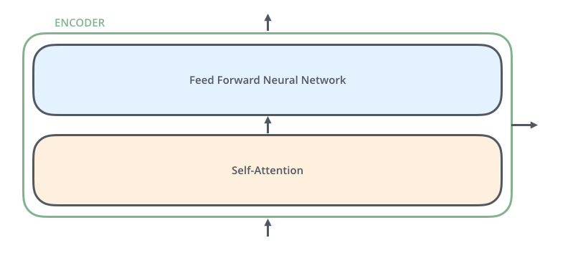
Transformer Architecture: A peep inside the Encoder

Slide 28
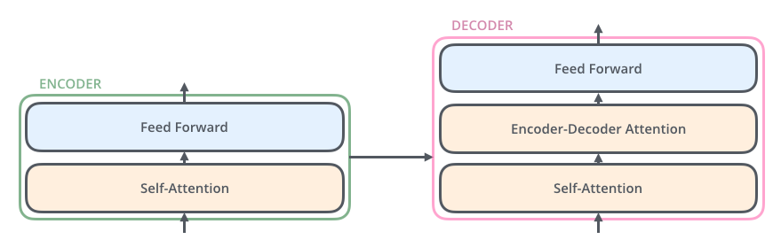
Transformer Architecture: Multi-layer Encoder-Decoder Model

Slide 29
Contextual Embedding: Self-Influence (preserving the DNA)
%
%
John
Mary
loves
%

Slide 30
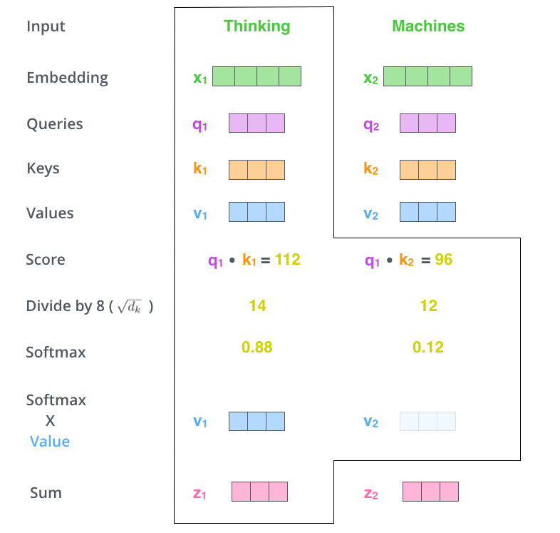
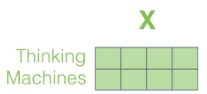
Transformer Architecture: Deeper inside the Encoder

Slide 31
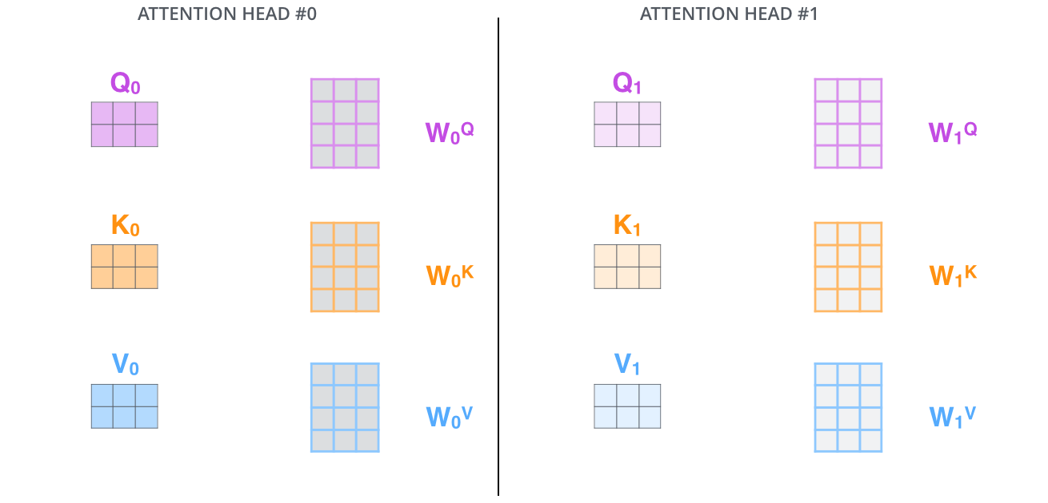
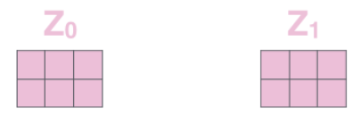
Transformer Architecture: Multi-head Encoder-Decoder Model

Slide 32
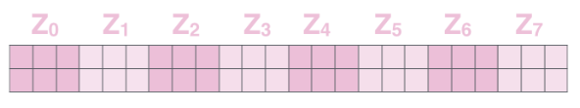
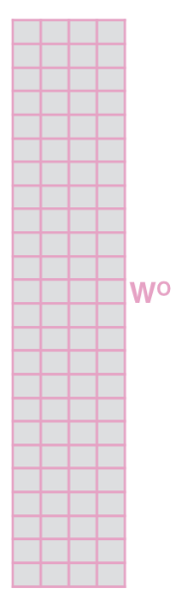
Getting the final Contextual Embeddings (Z)

Slide 33
Multi-Layer Contextualization

Slide 34
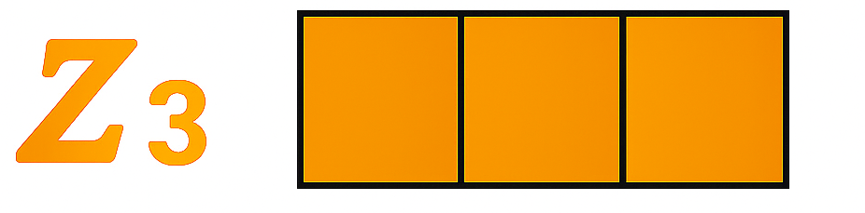
Position influences semantics
%
%
John
loves
Mary
%
%
%
%
John
Mary
loves

Slide 35


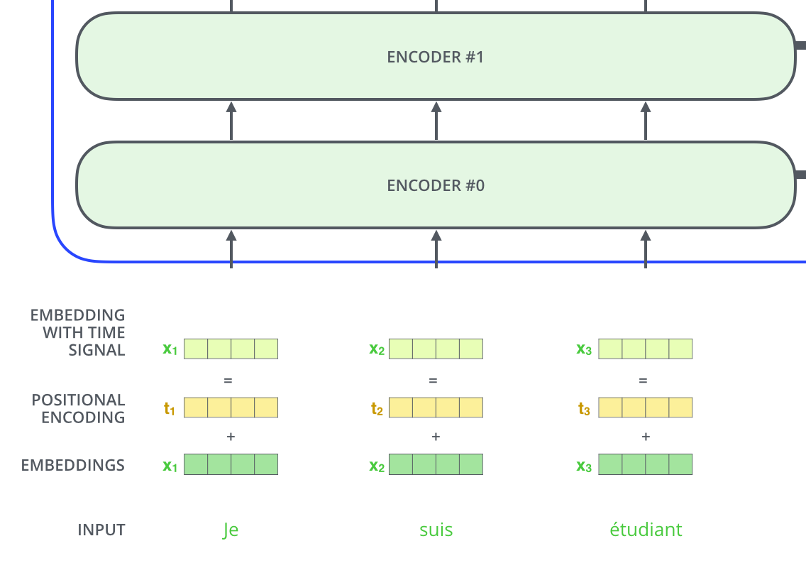
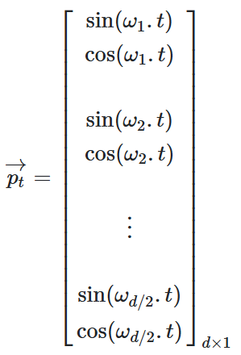
Injecting (Sinusoidal) Positional Encoding

Slide 36
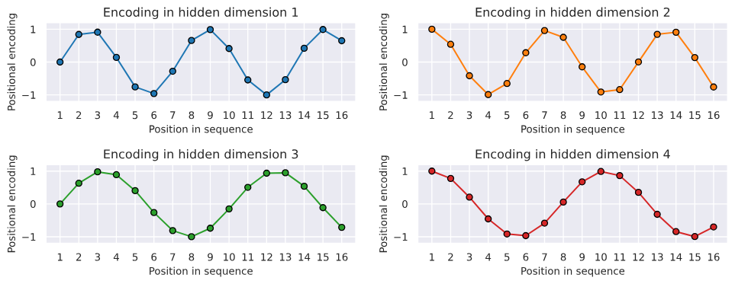
Injecting (Sinusoidal) Positional Encoding

Slide 37
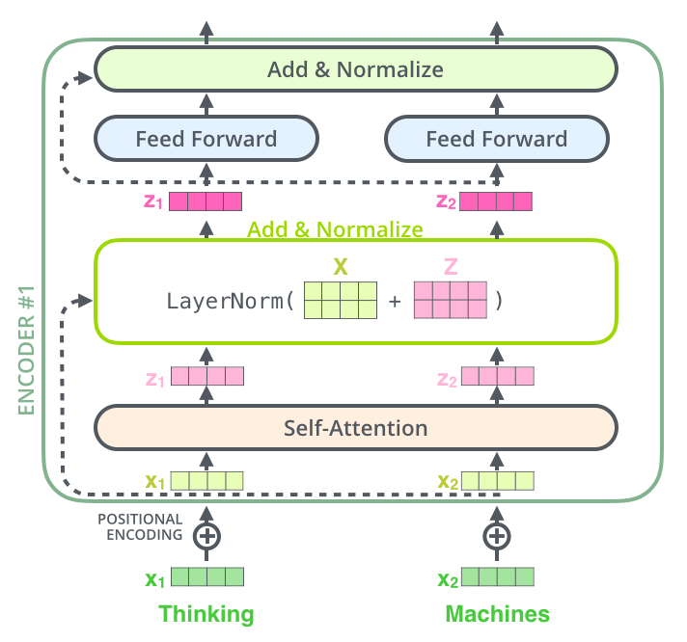
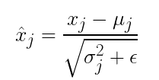
What if the original DNA gets lost over layers? Residuals

Slide 38
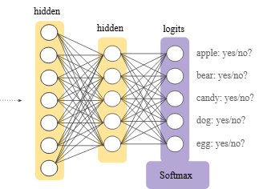
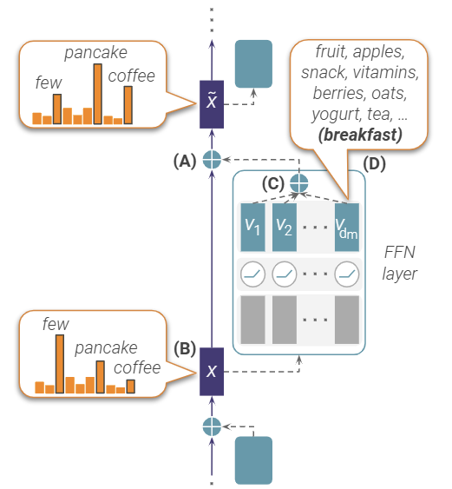
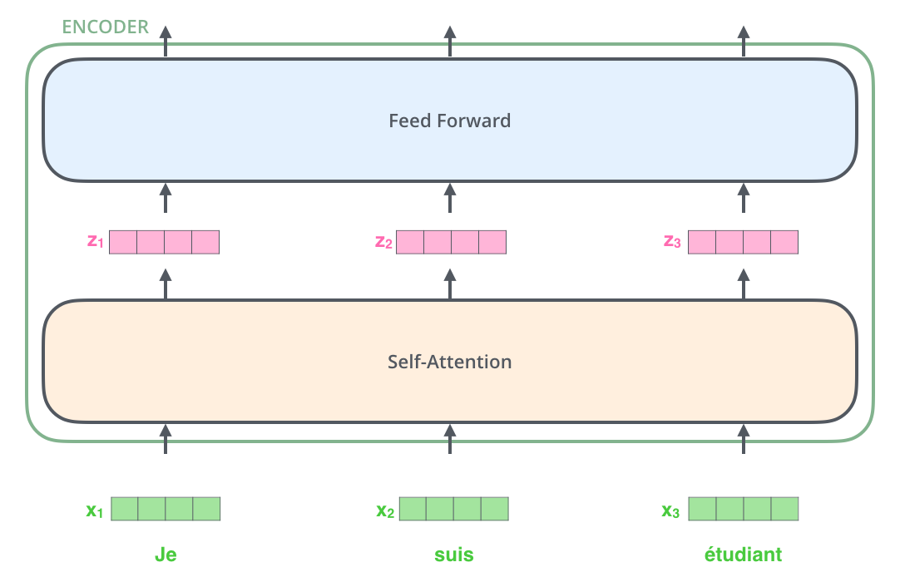
The final bit → Feed Forward Network (the real deal?)
Follow-up distr.

Slide 39
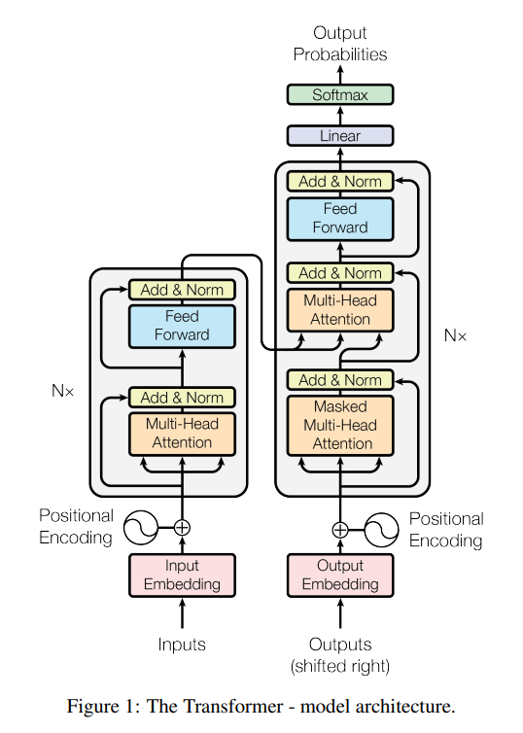
Transformer Architecture: The final Encoder

Slide 40
Transformer Architecture: The Decoder (Conditional LM)
Condition
Condition

Slide 41
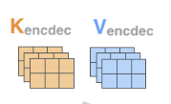

Transformer Architecture: Deeper into the Decoder
Condition
Condition Injected

Slide 42
(Forward) Masked Multi-Head Attention
x
%
John
Mary
loves

Slide 43
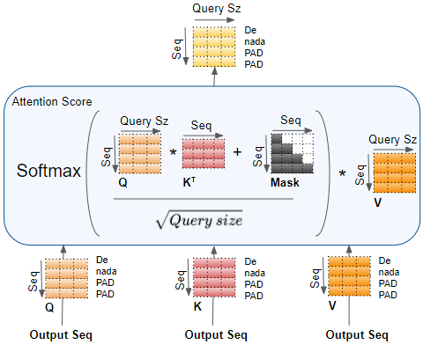
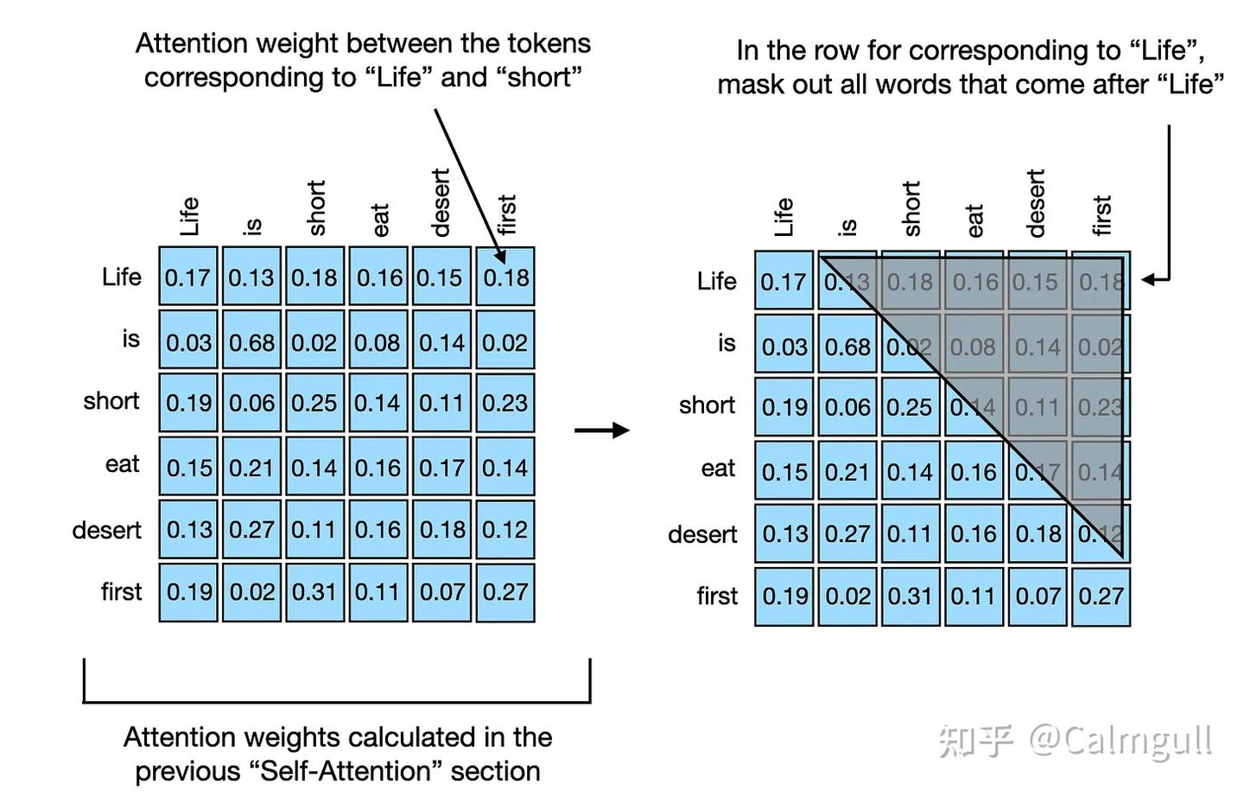
(Forward) Masking-based Self-Attention

Slide 44
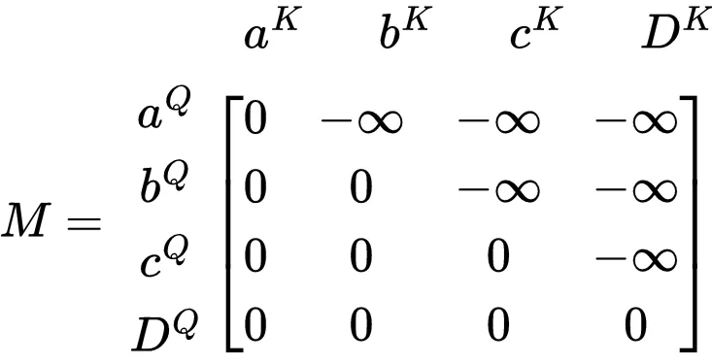
(Forward) Masked Multi-Head Attention

Slide 45
(Forward/Causal) Masked Multi-Head Attention

Slide 46
Transformer Architecture: Encoder-Decoder Attention
=

Slide 47
Training Datasets
📘 1. WMT 2014 English–German Dataset
📌 Key Points:
Size: Approximately 4.5 million sentence pairs.
Domain: News commentary, parliamentary proceedings (Europarl), and web-crawled data (Common Crawl).
Preprocessing: Includes tokenization, filtering of noisy or long sentences, and vocabulary construction via byte pair encoding (BPE).
📘 2. WMT 2014 English–French Dataset
📌 Key Points:
Size: Roughly 36 million sentence pairs, significantly larger than the En-De set.
Purpose: Used to evaluate model scalability and performance on a larger training corpus.
Performance: The Transformer model achieved state-of-the-art BLEU scores at the time on this dataset with much less training time than prior RNN-based models.

Slide 48
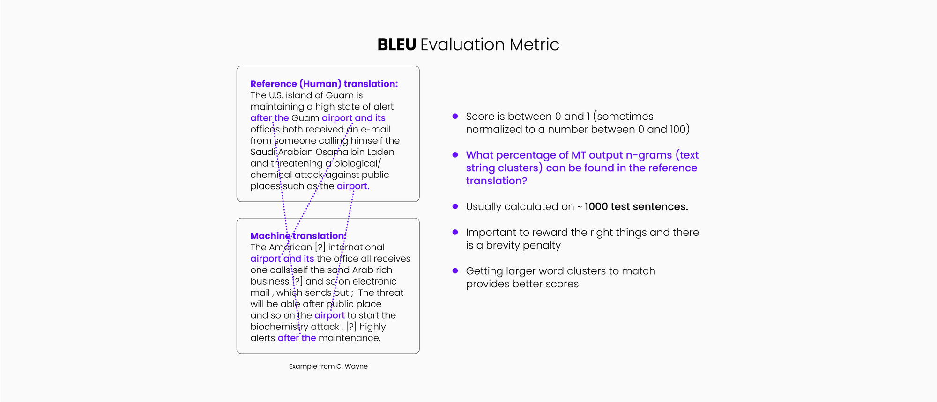
Evaluation
Reference (Target)
Candidate (Prediction via Auto-regression)

Slide 49
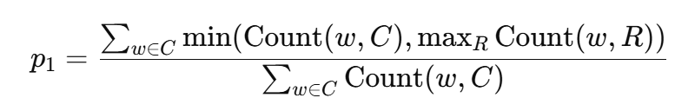
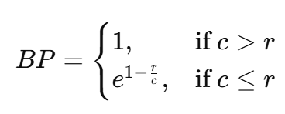

Evaluation

Slide 50
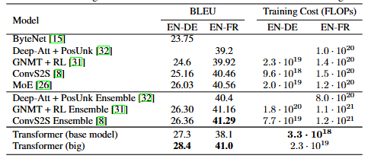
Evaluation

Slide 51
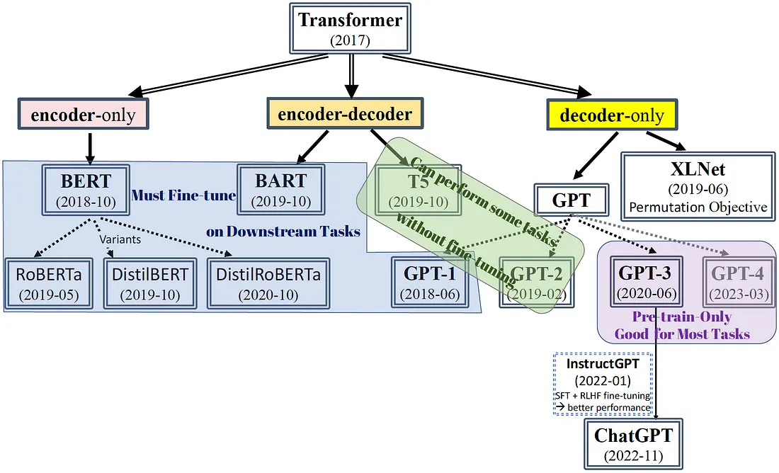
Transformer is the mother sauce of most modern LLMs

Slide 52
Core Image Credits
Jay Alammar, “Illustrated Transformer”
Yule Wang, “An In-Depth Look at the Transformer Based Models”
Gabriel Mongaras, “How Do Self-Attention Masks Work?”

